Slide 1
Vulnerability Assessments
Presented By:
RJ Hope, CPP
Kevin Whaley

Slide 2
Presenters
Robert “RJ” Hope, CPP
Section Manager - Security Consulting
Burns & McDonnell
Kevin Whaley
Security Consultant
Burns & McDonnell

Slide 3
Agenda
Why conduct a Vulnerability Assessment (VA)?
What is a Vulnerability Assessment?
Purpose/Frequency
Who should be involved
Types of Vulnerability Assessments
Vulnerabilities to consider
Mitigation Options & Cost Justifications

Slide 4
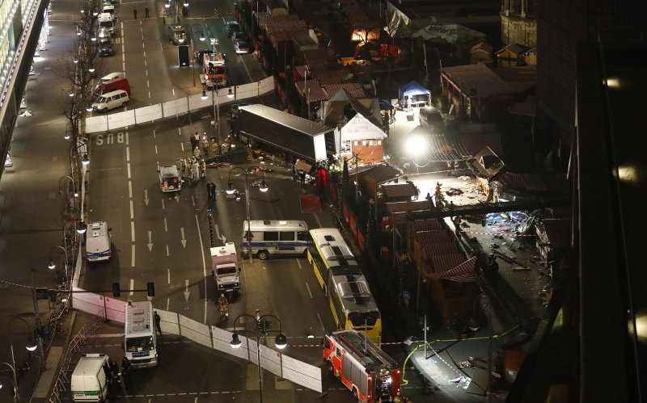
Why Vulnerability Assessments?
Past events
Berlin truck attack 19DEC2016
12 dead 56 injured
Trespasser at Eugene Sawyer Water Purification Plant NOV 2016

Slide 5
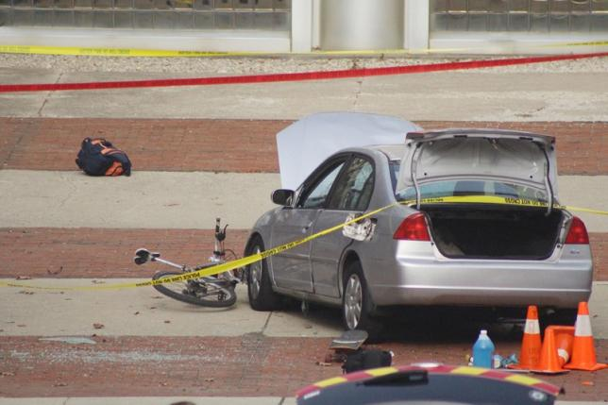
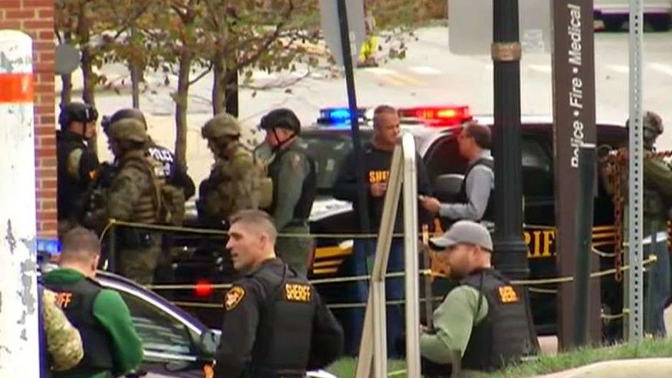
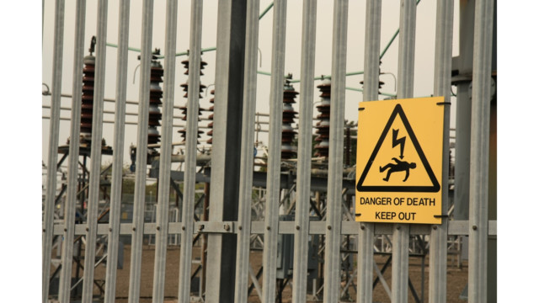
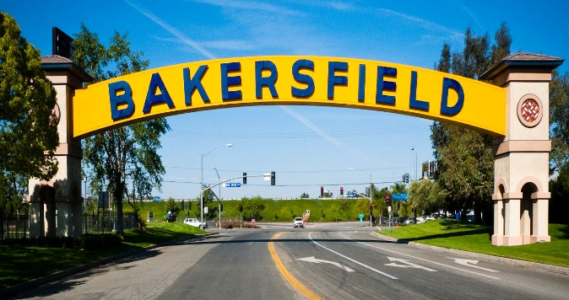
Past Events (continued)
Ohio State Attack 28NOV2016
11 injured
Bakersfield, CA
Substation Intrusion & Sabotage

Slide 6
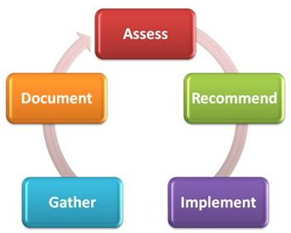
Why Vulnerability Assessments?

Slide 7
In-House vs. Outside Consultant
In-house vs. outside consultants
In-house can provide institutional knowledge about environment
Normally already know what the answers are to problems
May have issues getting buy-in from management/executives
Outside consultants can provide an objective perspective
Fresh set of eyes
Offer substantiation to findings
Offer insight into similar environments & experience from other industries

Slide 8
Assessment Methodologies
DoD – UFC 4-020-01
FEMA 452
FEMA 426
Sandia Labs
RAM-WTM (Water)
RAM-CFTM (Chemical)
RAM-CITM (Critical Infrastructure)
Prison, Energy, Transmission, Dams, Etc.
Department of Homeland Security
CARVER + Shock
Criticality
Accessibility
Recoverability
Vulnerability
Effect
Recognizability

Slide 9
What is a Vulnerability Assessment?
Threat, Vulnerability, & Risk Assessments defined
Vulnerability = process of identifying and quantifying vulnerabilities or weak points of a facility or PPS (Physical Protection System)
Threat = Means, methods and likelihood of attack
Outsider, insider, outsider colluding with insider.
Risk = process of determining the outcome of a successful attack and the effect on the entity.

Slide 10
Purpose & Frequency of VA
Establishes the baseline of the PPS effectiveness against your individually defined threats
Conduct initial assessment, post-mitigation assessment, periodic assessments
Should also be conducted:
After an event (direct or non-direct)
Changes in regulations (if any)
To coincide with industry best practices

Slide 11
Objectives of VA
Obtain an objective understanding of vulnerabilities to your operation based on your entities unique operating environment
Identify mitigation options that are commensurate with your operating environment and generate a Target Shift
Development of plans that can generate cost savings
THINKING LIKE AN ADVERSARY!

Slide 12
Objectives of VA
Understanding the Attack Model
Event Selection
Target Selection
Preoperational Surveillance
Attack Mobilization
Attack Method
Attack Dry Runs
Attack Sequence

Slide 13
Who is involved?
Team should consist of personnel with broad experience
Led by Security Specialist
Include:
Security Manager
Security Systems Specialist
IT
Front line Operators
Operations/Facilities
Legal & HR
May only be needed for specific items

Slide 14
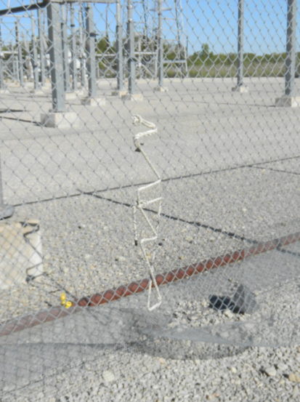
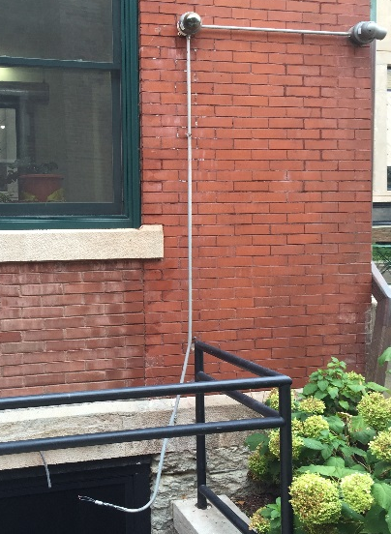
Vulnerability Examples
Physical Vulnerabilities
Barriers
Lighting
Doors
Fencing
Etc.
Personnel Vulnerabilities
Employees
Guard Force
Social Engineering
Electronic Vulnerabilities
Surveillance Cameras
Access Controls
Intrusion Detection
Program Vulnerabilities
Policies & Procedures

Slide 15
Types of VA
Performance Based
Compliance Based

Slide 16
Performance Based
Create an adversary sequence diagram
Conduct path analysis
Perform scenario analysis
Determine system effectiveness
If effectiveness (or risk) is unacceptable, develop and analyze upgrades.

Slide 17
Performance Based - Qualitative
AKA CARVER
Criticality – measure of impact of an attack
Accessibility – ability to physically access and egress from target
Recuperability – ability of a system to recover from an attack
Vulnerability – ease of accomplishing attack
Effect – amount of direct loss from an attack as measured by loss in production
Recognizability – ease of identifying target
A modified CARVER adds 7th attribute
Combined health, economic and psychological impacts of an attack

Slide 18
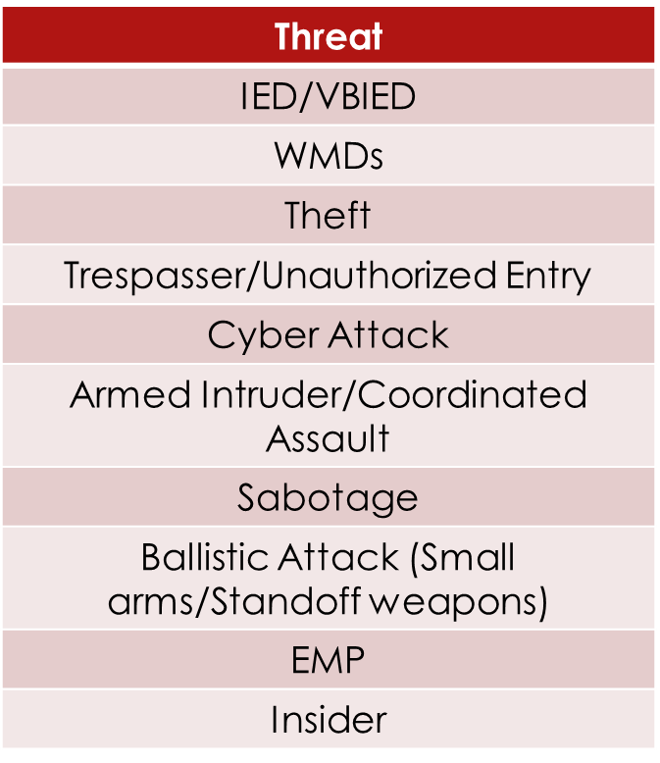
Performance Based - Scenario
Used to determine whether a PPS has vulnerabilities that could be exploited by adversaries using varying tactics.
Analyses PPS using defined threats and path analysis.

Slide 19
Performance Based – Scenario (continued)
Using assumptions about threats to determine how an event might occur, then determining if your systems can effectively assist with the mitigation
Threat Assumption Sample 1
Asset Theft: the unauthorized removal of facility assets.
Assumptions:
Adversary desires to remove the assets while minimizing potential detection or evidence that would lead to apprehension.
Assets subject to theft are high value commodities such as electronics, or metals.
Motivation for asset theft events is not driven by a desire to harm a facility but rather to acquire the asset components being removed. (Harm to the facility and operation can occur based on the type(s) of assets stolen and the associated downtime associated with asset replacement.)

Slide 20
Performance Based - Quantitative
Requires measurable data
Security systems performance and cost
Usually used for corporations with unacceptably high consequence of loss
Nuclear facilities, prisons, certain government or military installations, refineries, utilities, airports, telecommunication hubs.
Used mainly to measure hardware components performance
CCTV, sensors, access controls, etc.
Removes the subjectivity of compliance based or qualitative analysis.

Slide 21
Compliance Based
Measures the conformance to specified policies or programs driven by the regulatory body within an industry.

Slide 22
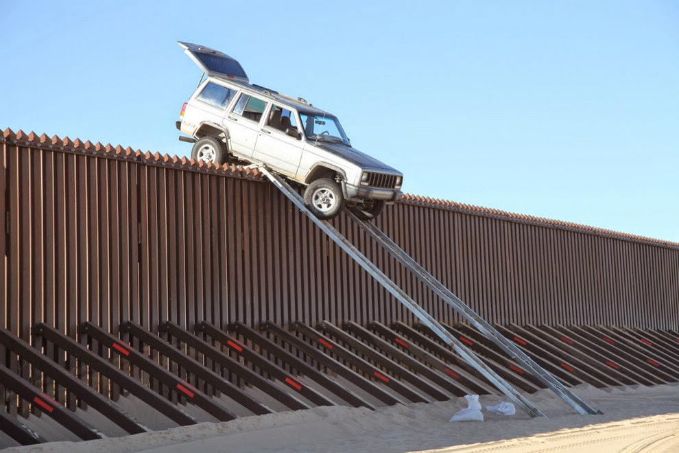
Options for Mitigation
Show me an 11’ fence & I’ll show you a 12’ ladder
EVERYTHING can be defeated
GOAL IS TO CREATE TARGET SHIFT
You don’t want to get video of an event, you want there to be no event to capture
Mitigations = level of protection desired + acceptable risk
Limited only by your creativity
May not always be a security technology or additional personnel
Industry Perception

Slide 23
Cost Justification
Regulatory vs. Non-Regulatory
Carrot and Stick
Required Improvements
Security Overkill
Event Based vs. Non-Event Based
Fear
Apprehension
Employee Retention

Slide 24
Cost Justification
Events vs. Regulatory
Program Longevity
Implementation Thought Process
Stakeholder Involvement
Leadership Support
Litigation vs. Fines
Relation to Peers
Lowering of O&M
Demonstrated Reduction of Events
Reduction/Elimination of Regulatory Non-Compliance

Slide 25
Cost Justification
The Argument
Success is a Non-Event
Rated on Failure NOT Success
Rated Against Peers
Writing/Telling the Story

Slide 26
Questions
Robert J. Hope, CPP
Manager – Security Consulting
Burns & McDonnell Engineering
816-349-6754
rjhope@burnsmcd.com
Kevin Whaley
Security Consulting
Burns & McDonnell Engineering
816-447-9876
ktwhaley@burnsmcd.com

